Slide 1

Aeronautical Mobile Telemetry
Preston Walker, Benjamin Havens, Gustavo Oliveira, Riley Kirkwood, Joe Lamb, Michael Rice, Willie Harrison

Slide 2
Outline
Background
Past Work
Our Project
Future Work
Ethics
Conclusion

Slide 3


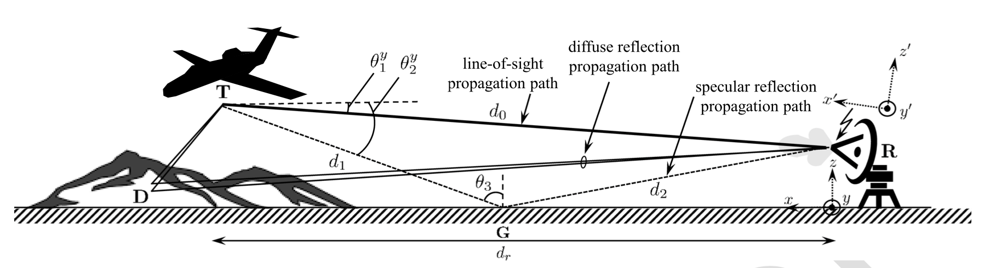
Background What is Aeronautical Mobile Telemetry?
How wireless signals are sent from air to ground during flight
Complicated by multipath propagation and the orientation of the transmitter

Slide 4
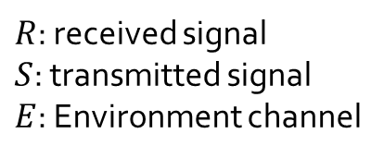
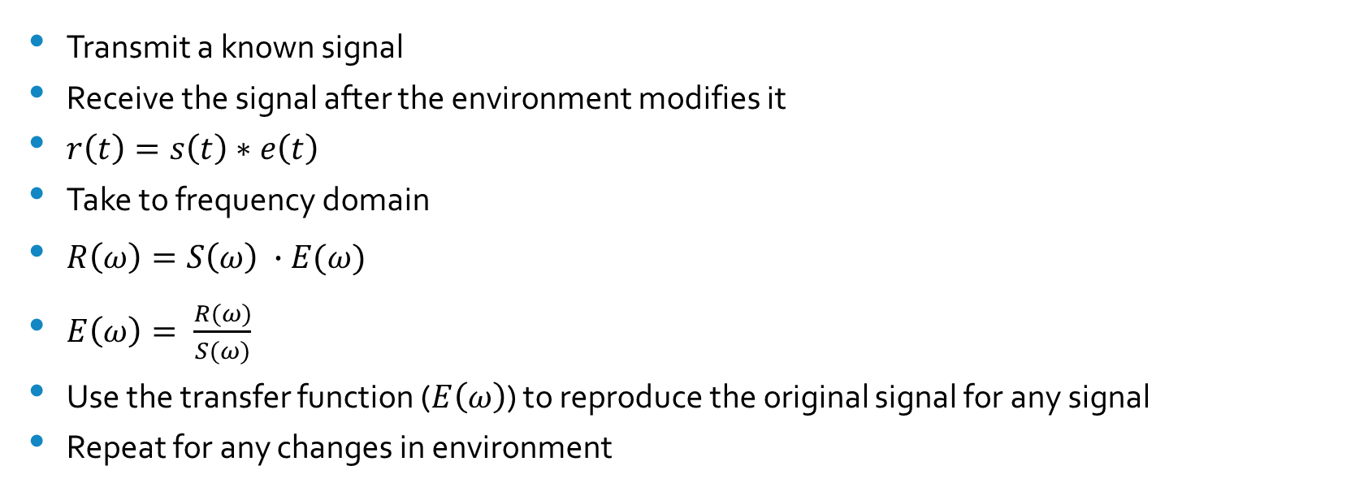
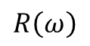
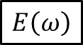
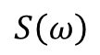
Past Work Dealing with Multipath Propagation
$R$: received signal
$S$: transmitted signal
$E$: Environment channel
$$S\left(ω\right)$$
$$E\left(ω\right)$$
$$R\left(ω\right)$$
Transmit a known signal
Receive the signal after the environment modifies it
$r\left(t\right)=s\left(t\right)∗e\left(t\right)$
Take to frequency domain
$R\left(ω\right)=S\left(ω\right) ∙E(ω)$
$E\left(ω\right)= \frac{R(ω)}{S(ω)}$
Use the transfer function ($E\left(ω\right)$) to reproduce the original signal for any signal
Repeat for any changes in environment

Slide 5
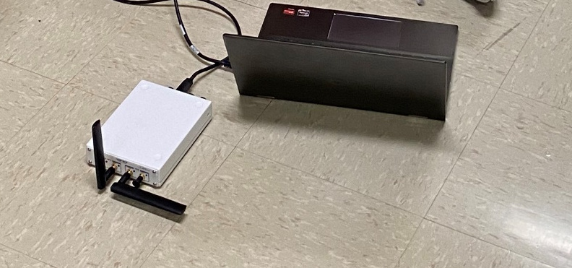
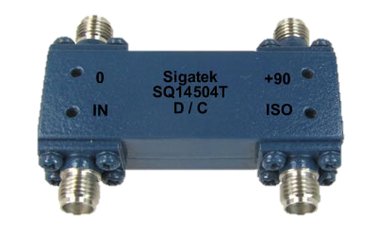
Past Work Receiving on two polarizations
Maximum Likelihood
Maximum Ratio Combining
Combining vertical and horizontal polarizations without a hybrid coupler
Not thoroughly tested (the purpose of our project)
Combining vertical and horizontal polarizations with a hybrid coupler
3 dB signal loss

Slide 6
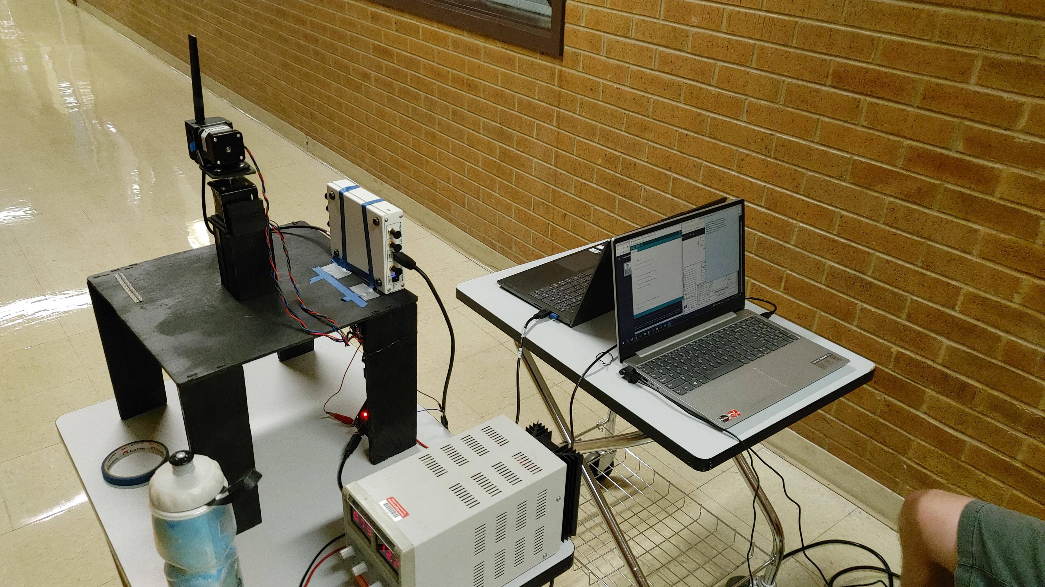
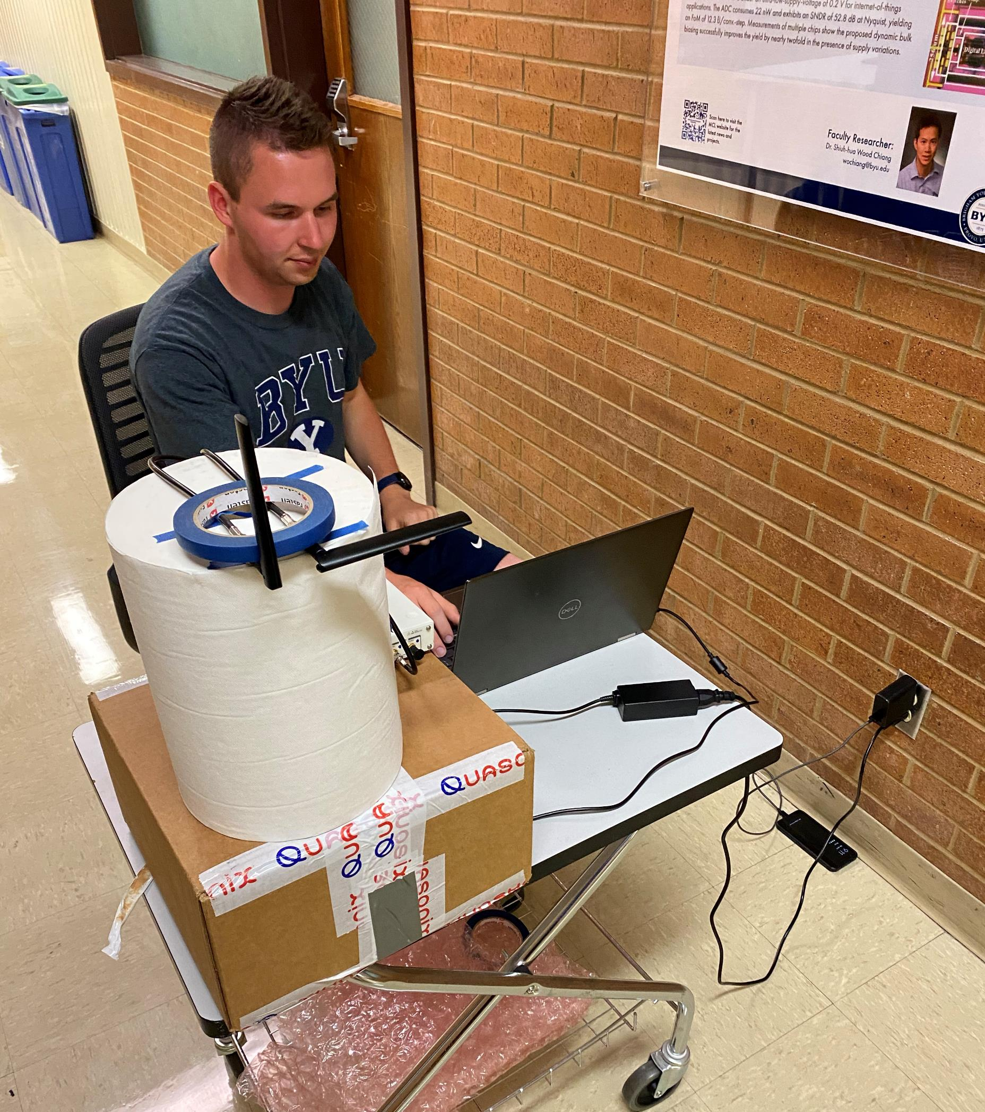
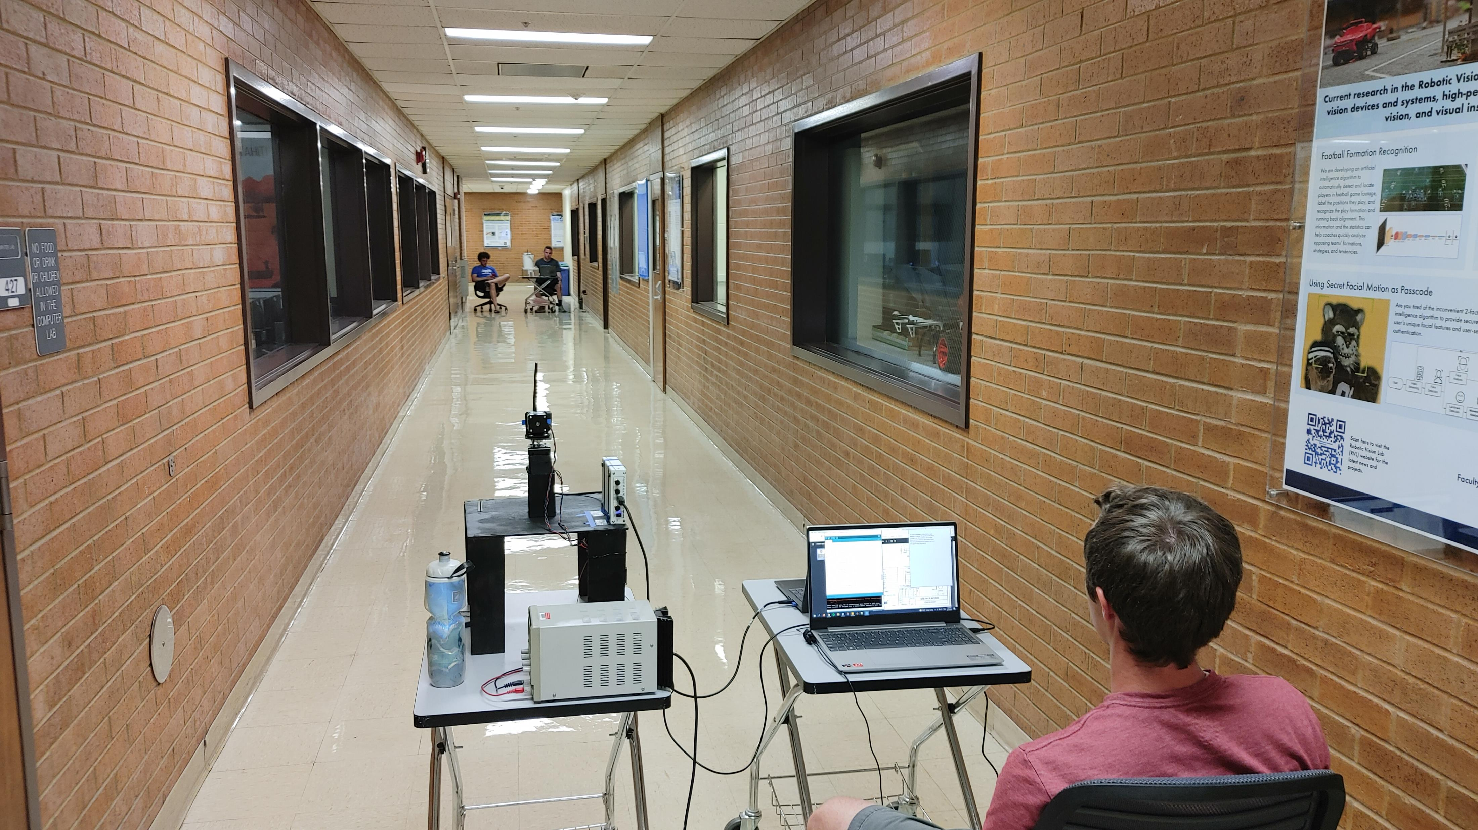
Our Project
Measure the response of a sounding signal transmitted down the hallway in order to approximate an impulse response.

Slide 7
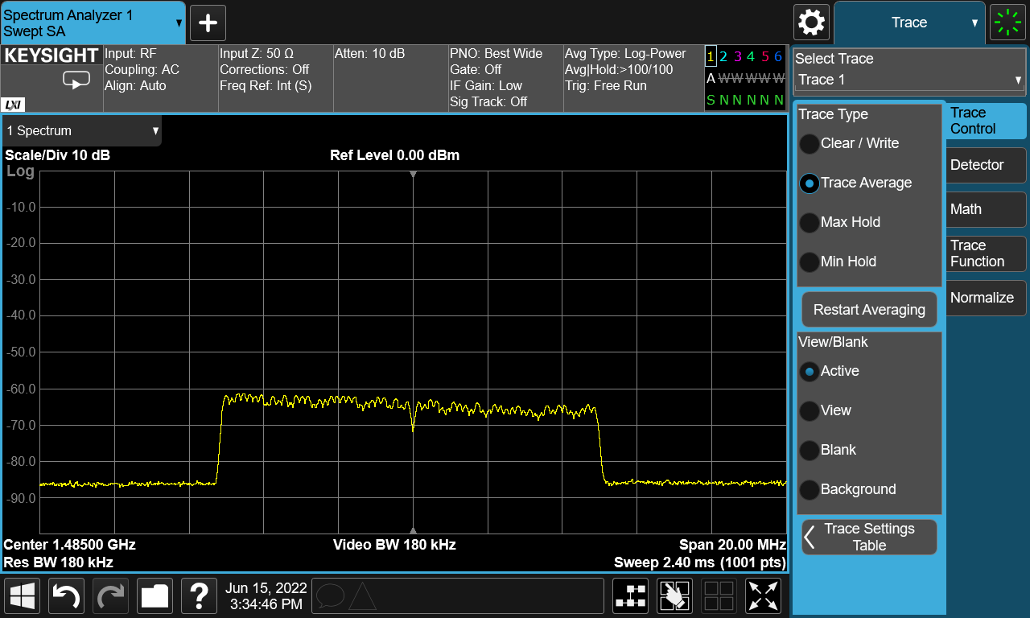

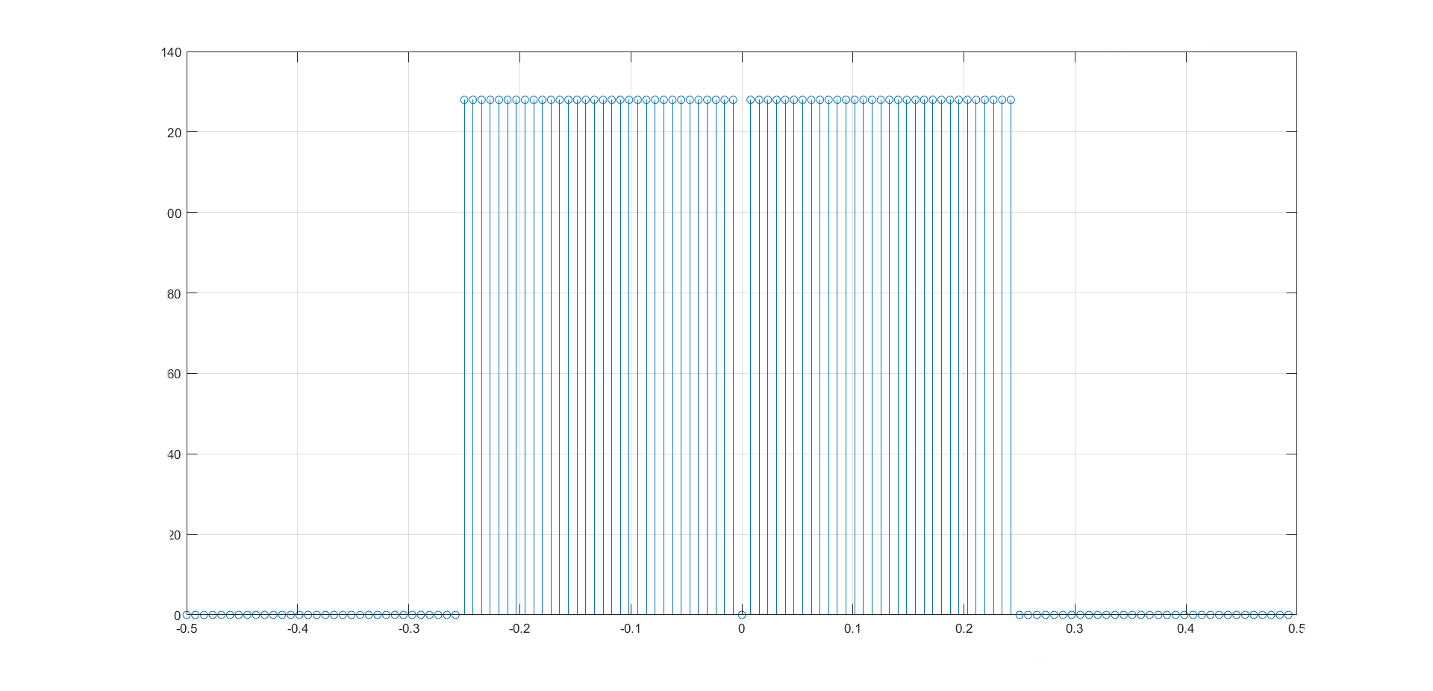
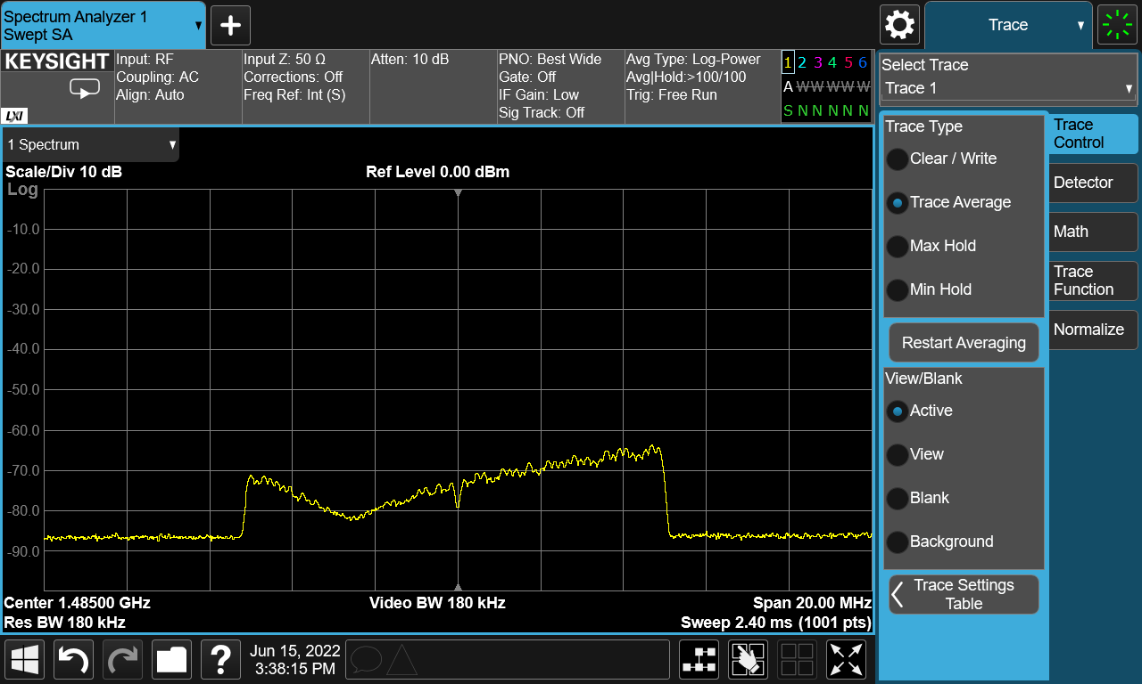
Our Project Sounding Signal
What we receive:
What we send:
Magnitude
Normalized Frequency
Heavily impacted by multipath propagation

Slide 8
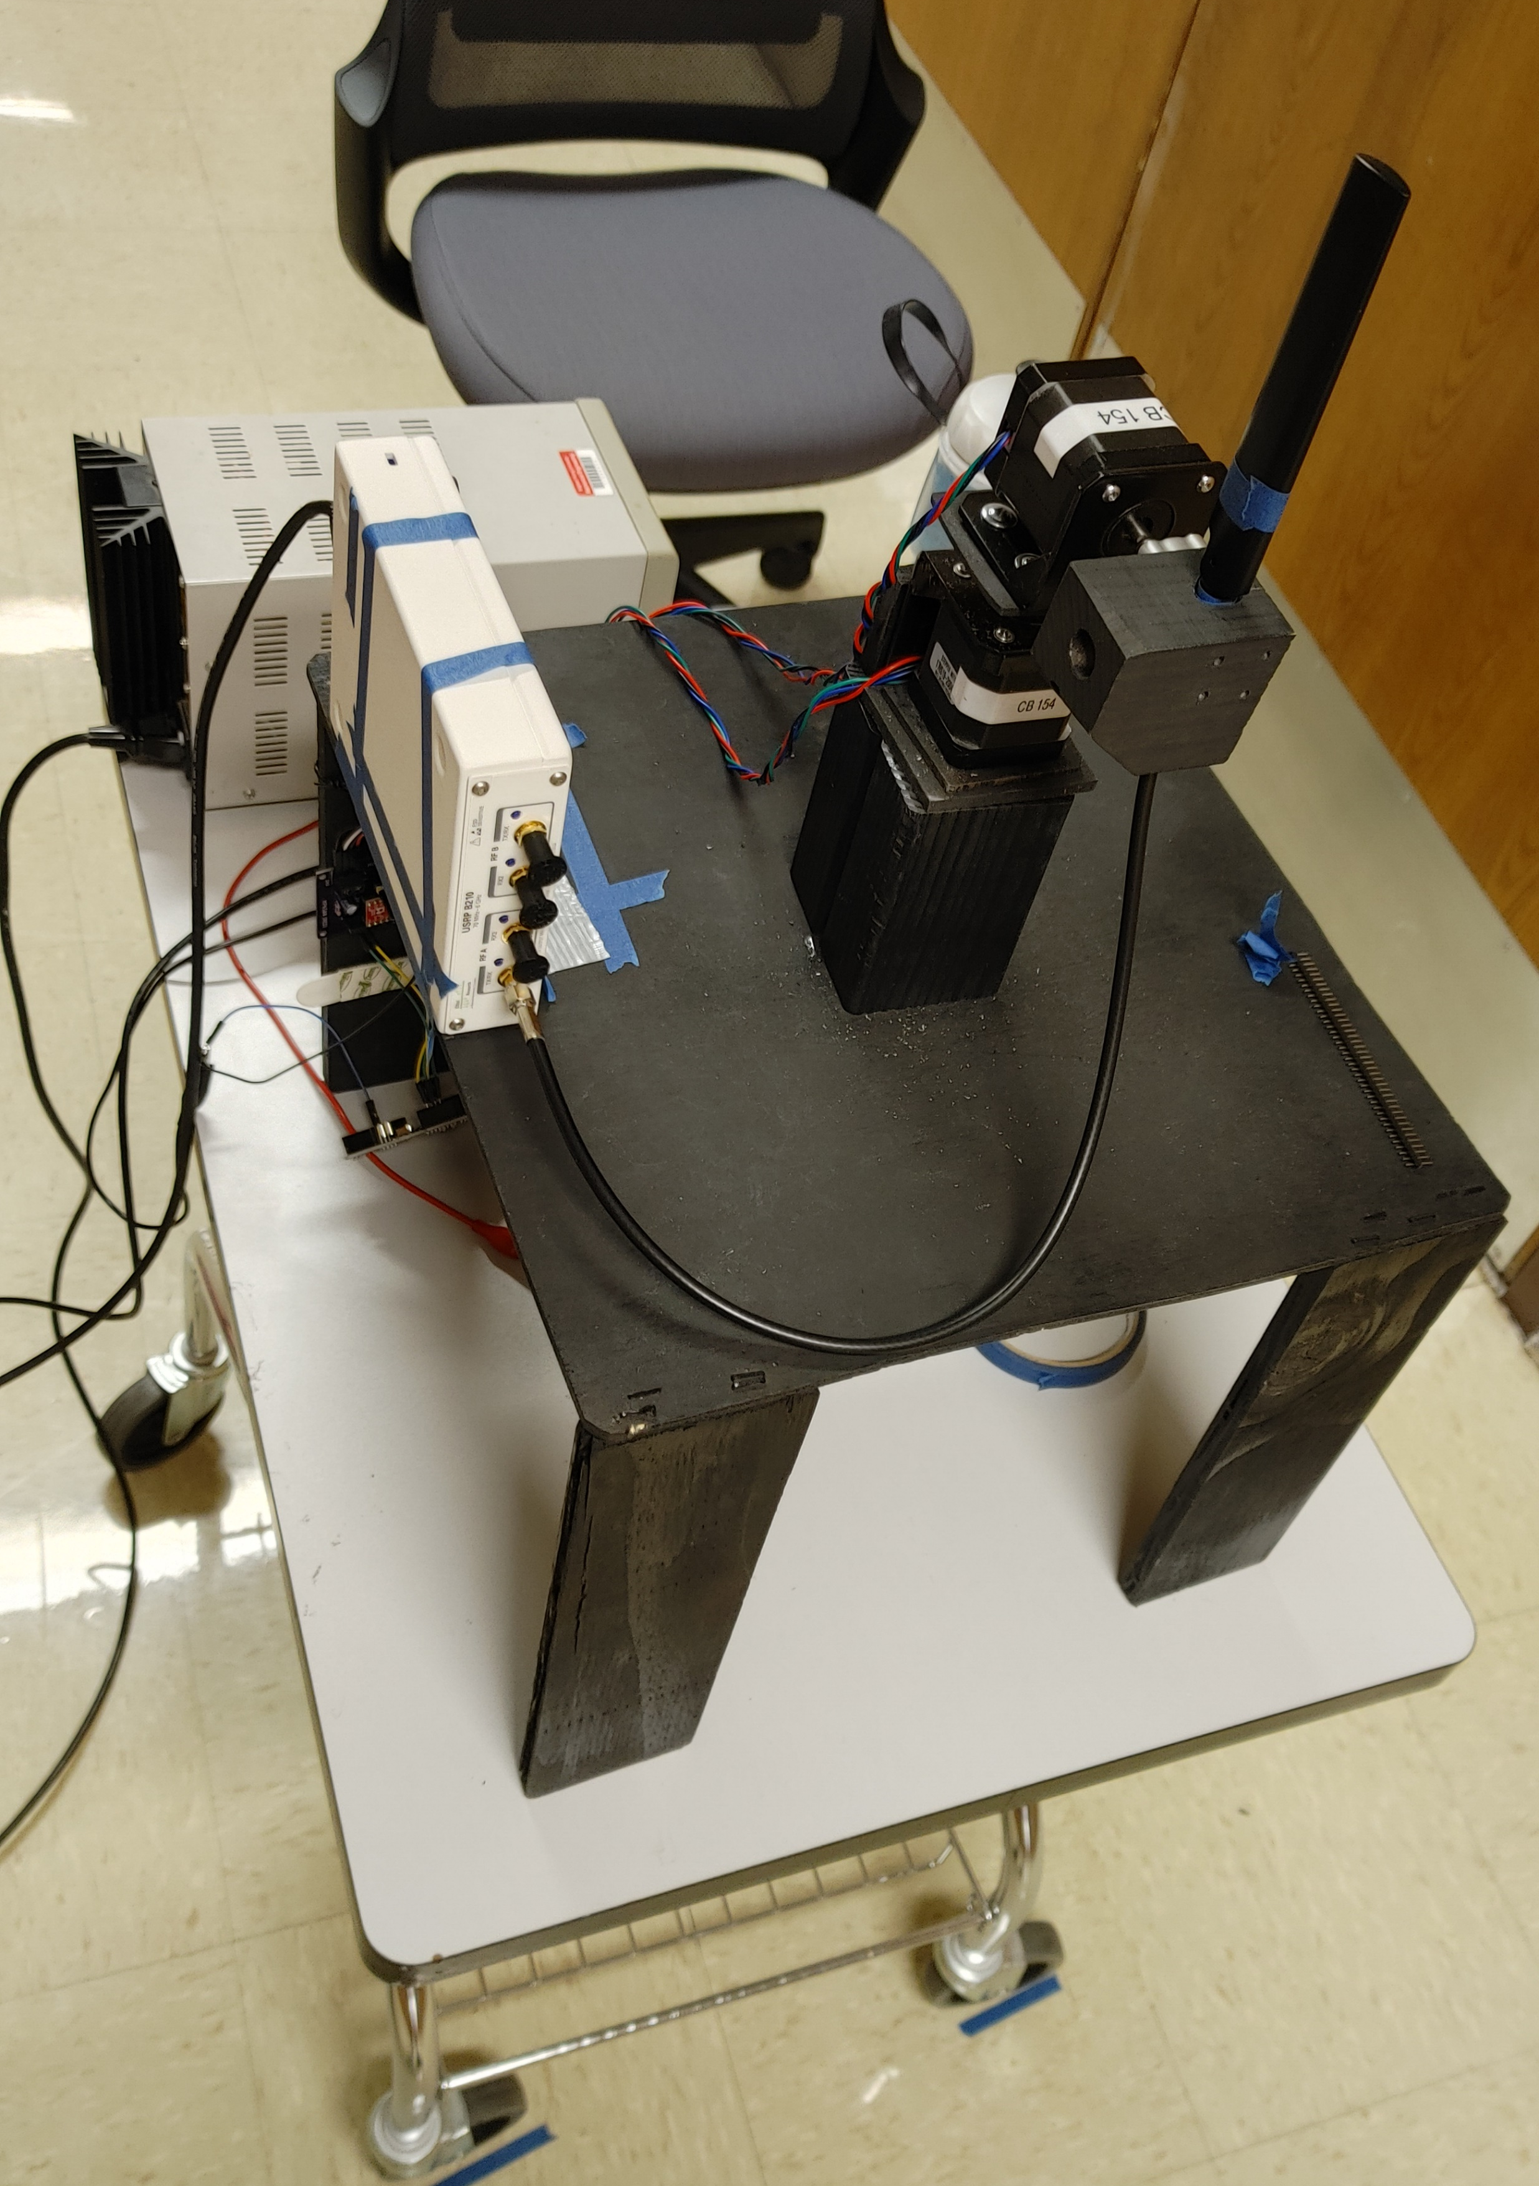
Our Project Data collection
Collect at night to avoid interference
A channel with a lot of multipath propagation will more rigorously test the combining methods
Mount the transmitter on a stepper motor controlled by an Arduino to transmit at 10-degree increments (simulating a plane at different orientations)

Slide 9
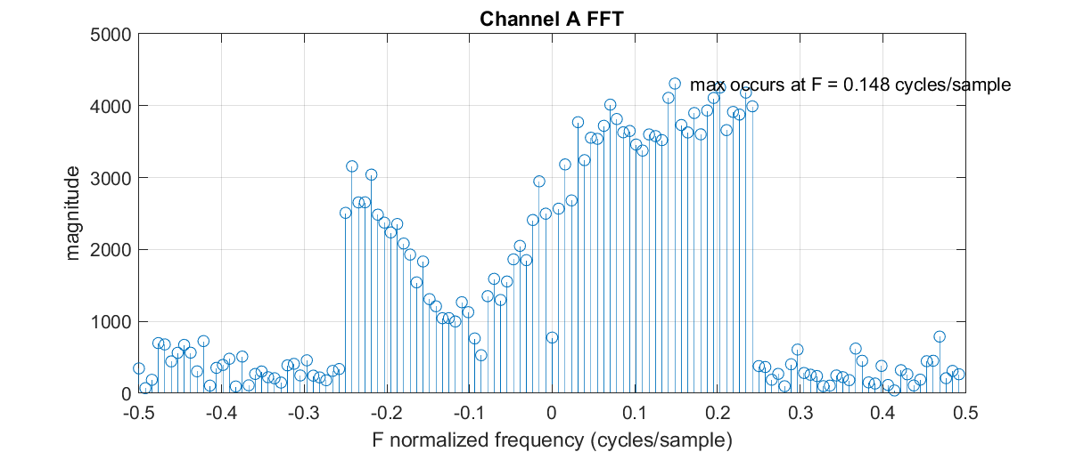
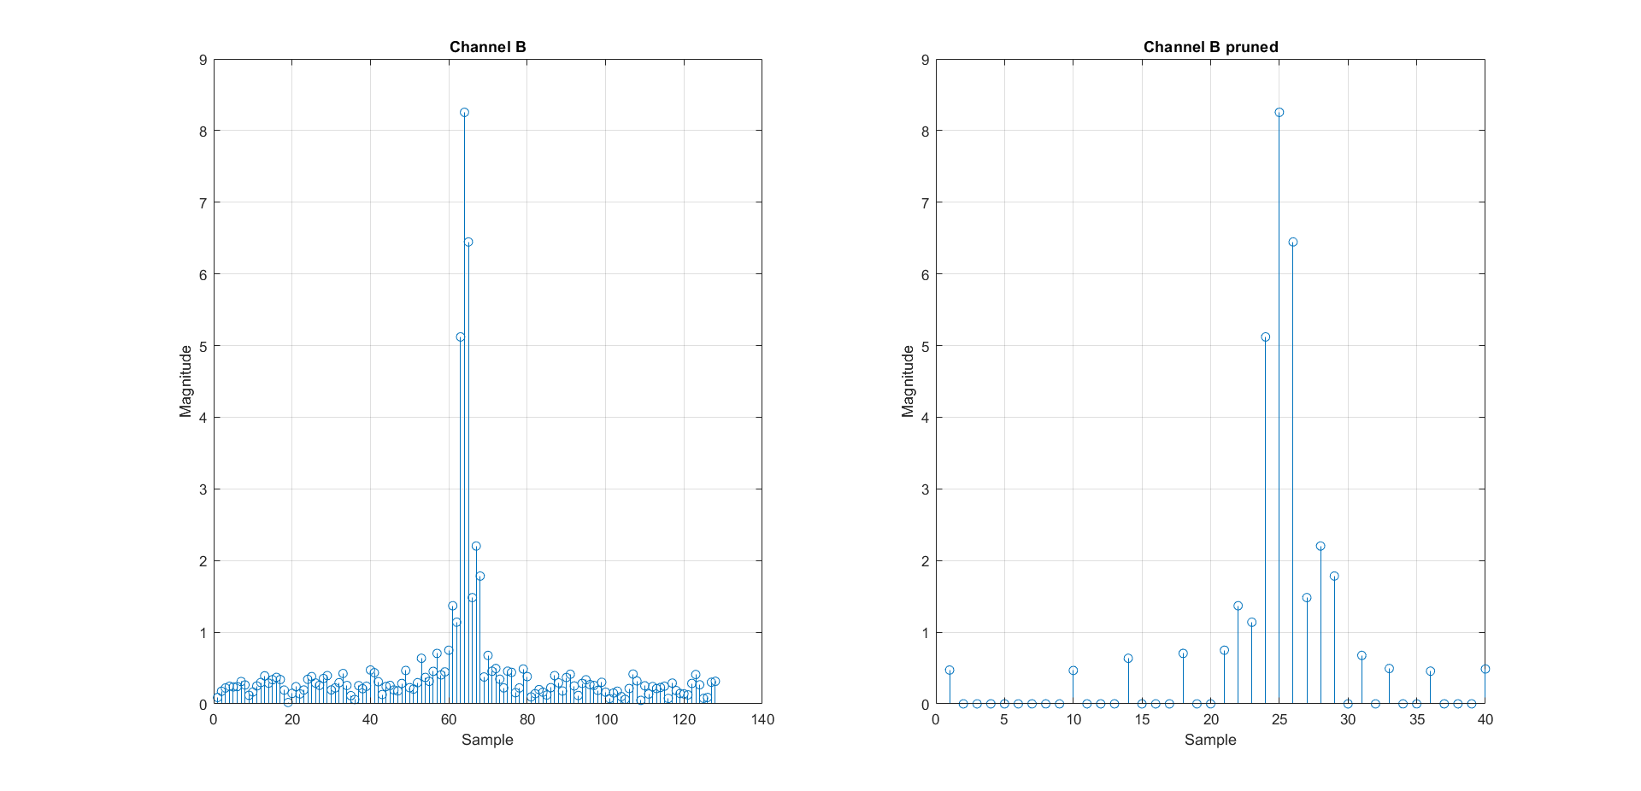
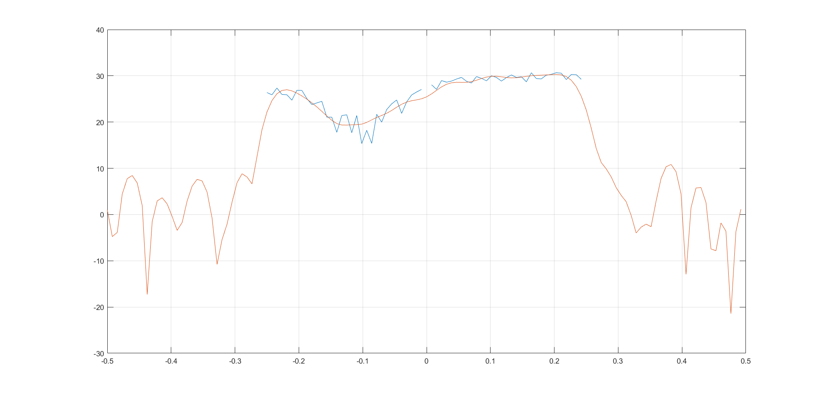
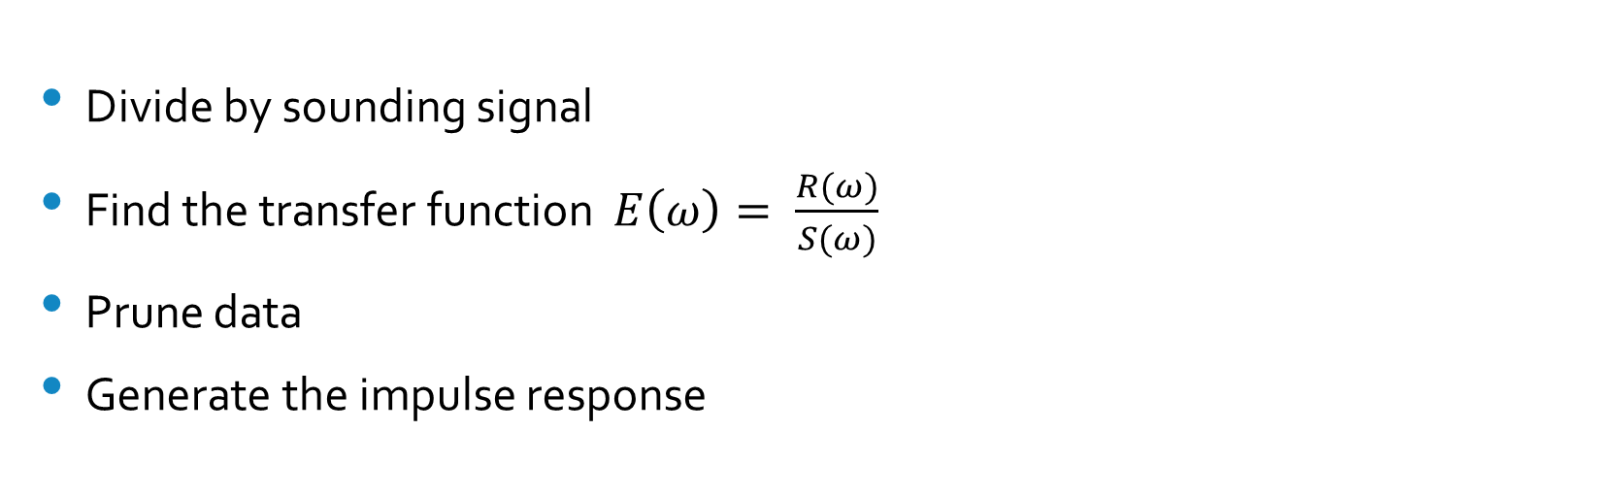
Our Project Impulse Response & Transfer Function
Divide by sounding signal
Find the transfer function $E\left(ω\right)= \frac{R(ω)}{S(ω)}$
Prune data
Generate the impulse response
Magnitude (Db)
Normalized Frequency

Slide 10

Future Work
Find the bit error rate of our results
Determine effectiveness of Maximum Likelihood combining vs Maximum Ratio Combining
Perform tests with signals other than the sounding signal we used
Test from an actual plane

Slide 11
Ethics Understanding the limitations of our tests
From IEEE code of ethics:
5. to seek, accept, and offer honest criticism of technical work, to acknowledge and correct errors, to be honest and realistic in stating claims or estimates based on available data, and to credit properly the contributions of others;
Can our tests from a hallway fully reflect the transmission of a signal from a plane?
Do the results change when the distance increases?
Are there certain environments where one combining method performs better than usual?

Slide 12
Conclusion
The project is not finished, but we have learned a lot about the process of sending and receiving radio signals
Depending on the results, Maximum Likelihood combining may one day replace Maximum Ratio Combining
Eliminates the need for a hybrid coupler
May result in more accurate wireless transmission from air to ground, leading to safer flights

Slide 13
Sources
F. Arabian and M. Rice, "On Polarization, Combining, and Equalization in Aeronautical Mobile Telemetry," in IEEE Transactions on Aerospace and Electronic Systems, doi: 10.1109/TAES.2022.3157275.

